Slide 1
THE INQUERY Retrieval System
Presented by :
Mohammed Nauman Siddique

Slide 2
What is the INQUERY Retrieval System?
Based on probabilistic retrieval model called inference net
Provides support for sophisticated indexing and query formulation

Slide 3
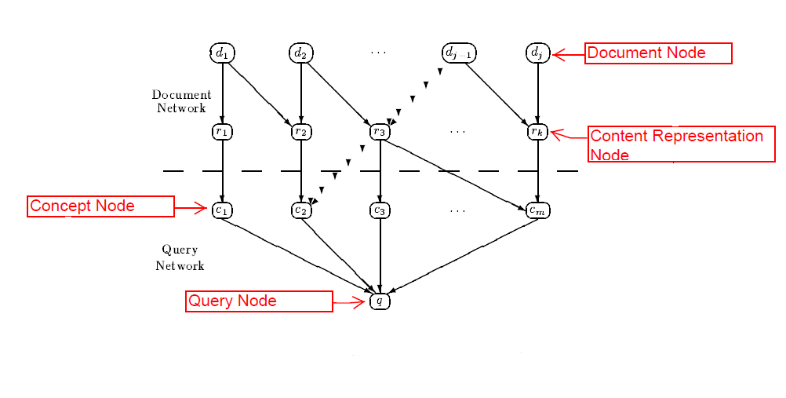
Document Retrieval Inference Network Model
from : Callan et al. , The INQUERY Retrieval System,1992, Springer Verlag

Slide 4
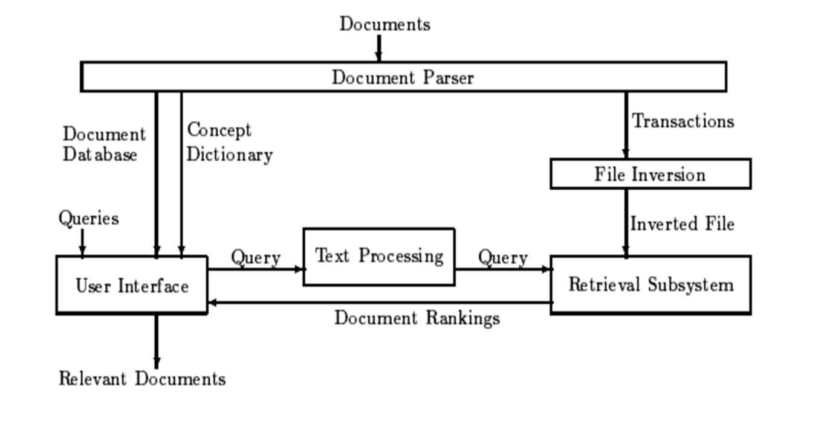
Architecture of INQUERY Retrieval System
from : Callan et al. , The INQUERY Retrieval System,1992, Springer Verlag

Slide 5
Parsing Subsystem
Lexical Analysis
Syntactic Analysis
Concept Identification
Dictionary Storage
Transaction Generation

Slide 6
Rest of the Architecture Components
File Inversion
Retrieval Subsystem
User Interface

Slide 7
A Case For Interaction : A Study of Interactive Information Retrieval Behavior and Effectiveness

Slide 8
Purpose of the Paper
Use and effectiveness of INQUERY Information Retrieval Systems
Investigates the information seeking behavior of 64 novice users who used one base line version for interaction and three relevance feedback based interaction retrieval systems

Slide 9
Interaction methods used in the paper
Baseline Interface
Opaque Interface Relevance Feedback
Transparent Interface Relevance Feedback
Penetrable Interface Relevance Feedback

Slide 10
Questions dealt in the research
Can the full text retrieval systems combined with operator-free query language be used in an effective way by users with little training?
Is the relevance feedback effective?
Is the user knowledge about the output of the relevance feedback helpful?

Slide 11
Questions dealt in the research (Continued…..)
Is user control over the operation of the relevance feedback system useful?
How do different levels of interaction impact the information seeking behavior of the user?

Slide 12
Set Up for the Research
64 novice users
Dataset consisted of 74,520 articles from Wall Street Journal
Two search topics : Automobile Recall and Tobacco Advertising and the Young

Slide 13
Experimental Design and Procedures
Allotted time of 45 minutes for baseline interface tutorial
20 minutes for query formulation on first search
Reviewing feedback interfaces
20 minutes for query formulation on second search
A short interview about their experience

Slide 14
Training on Tutorials
Baseline Interface Training : 26 minutes
Relevance Feedback Training :
Opaque : 6.5 minutes
Transparent and Penetrable : 10 minutes

Slide 15
Effectiveness
Relevance feedback users performed 17% to 34% better than baseline interface users
Users in penetrable interface performed 15% better than users of opaque and transparent feedback interface

Slide 16
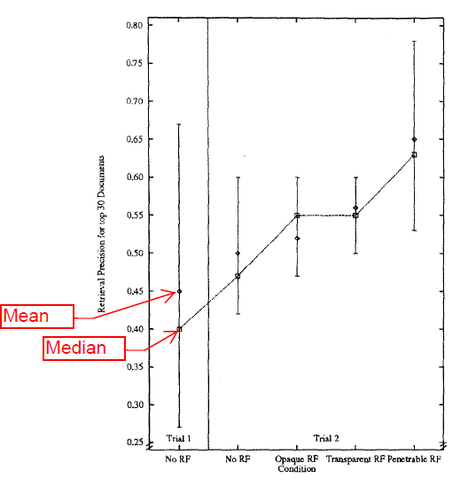
Retrieval Precision at 30 Documents for Final Queries
from : Koenemann et al. , A Case for Interaction: A Study of Interactive Information
Retrieval Behavior and Effectiveness ,1996, ACM

Slide 17
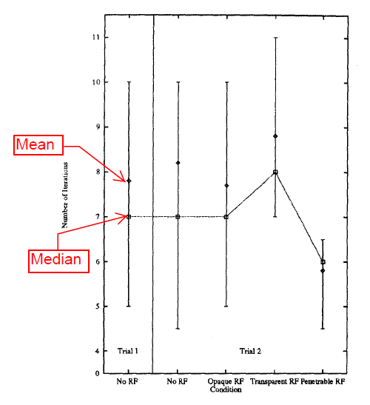
Results on Number of Iterations
from : Koenemann et al. , A Case for Interaction: A Study of Interactive Information
Retrieval Behavior and Effectiveness ,1996, ACM

Slide 18
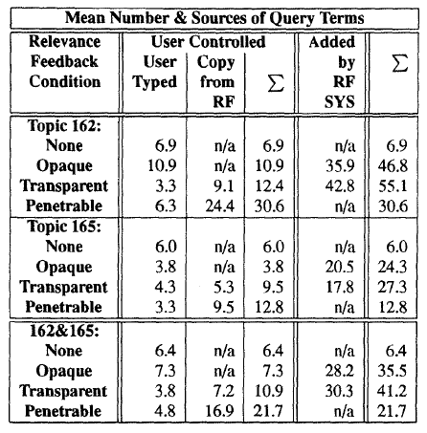
Results on Number and Sources of Query Terms in Final Query
from : Koenemann et al. , A Case for Interaction: A Study of Interactive Information
Retrieval Behavior and Effectiveness ,1996, ACM

Slide 19
Conclusion
All users declared relevance feedback mechanism as their preference over baseline in the post-experiment interview.
Relevance feedback improved median performance by 10% (or more) at 30 retrieved documents.
Penetrable relevance feedback mechanism was most efficient.
Users commented that using the feedback mechanism made them lazy.

